Slide 1
ASSEMBLY LANGUAGE
Michael D’Argenio – mjdargen@ncsu.edu
Electrical Engineering – SS 2019 – Duke TIP

Slide 2
LC-3

Slide 3
Instruction Set Architecture (ISA)
ISA – all of the programmer-visible components and operations of the computer
memory organization
    address space -- how may locations can be addressed?
    addressability -- how many bits per location?
register set
    how many? what size? how are they used?
instruction set
    opcodes
    data types
    addressing modes

Slide 4
Instruction Set Architecture (ISA)
ISA provides all information needed for someone that wants to write a program in machine language.
Allows you to translate from a high-level language to machine language.
Or more effectively write programs in high-level language for the target processor by understanding the drawbacks of the ISA.

Slide 5
LC-3 Overview: Memory and Registers
Memory
  address space: 2¹⁶ locations (16-bit addresses)
  addressability: 16 bits
Registers
  temporary storage, accessed in a single machine cycle
    accessing memory generally takes longer than a single cycle
  eight general-purpose registers: R0 - R7
    each 16 bits wide
    how many bits to uniquely identify a register?
  other registers
    not directly addressable, but used by (and affected by) instructions
    PC (program counter), condition codes

Slide 6
LC-3 Overview: Instruction Set
Opcodes
  15 opcodes
  some opcodes set/clear condition codes, based on result:
    N = negative, Z = zero, P = positive (> 0)
Data Types
  16-bit 2’s complement integer
Addressing Modes
  How is the location of an operand specified?
  non-memory addresses: immediate, register
  memory addresses: PC-relative, indirect, base+offset

Slide 7
LC-3 Opcodes
Operate instructions:
  ADD
  AND
  NOT
Data movement instructions:
  LD – PC relative mode
  LDI – indirect mode
  LDR – base+offset mode
  LEA - Load effective address -- compute address,save in register
  ST – PC relative mode
  STI – indirect mode
  STR – base+offset mode
Control instructions:
  BR
  JSR
  JMP
  RTI
  TRAP

Slide 8
Operate Instructions
Only three operations: ADD, AND, NOT
Source and destination operands are registers
  These instructions do not reference memory.
  ADD and AND can use “immediate” mode,
  where one operand is hard-wired into the instruction.
Will show dataflow diagram with each instruction.
  illustrates when and where data moves to accomplish the desired operation

Slide 9
Data Movement Instructions
Load - read data from memory to register
  LD: PC-relative mode
  LDR: base+offset mode
  LDI: indirect mode
Store - write data from register to memory
  ST: PC-relative mode
  STR: base+offset mode
  STI: indirect mode
Load effective address - compute address, save in reg
  LEA: immediate mode
  does not access memory

Slide 10
Control Instructions
Used to alter the sequence of instructions (by changing the Program Counter)
Conditional Branch
  branch is taken if a specified condition is true
    signed offset is added to PC to yield new PC
  else, the branch is not taken
    PC is not changed, points to the next sequential instruction
Unconditional Branch (or Jump) always changes the PC
TRAP
  changes PC to the address of an OS “service routine”
  Returns control to the next instruction(after TRAP

Slide 11
Condition Codes
LC-3 has three condition code registers:
  N – negative
  Z – zero
  P – positive (greater than zero)
Set by any instruction that writes a value to a register
  (ADD, AND, NOT, LD, LDR, LDI, LEA)
Exactly one will be set at all times
  Based on the last instruction that altered a register

Slide 12
Example Program
Compute sum of 12 integers.
  Numbers start at location x3100.
  Program starts at location x3000.
R1 ← x3100
R3 ← 0
R2 ← 12
R2=0?
R4 ← M[R1]
R3 ← R3+R4
R1 ← R1+1
R2 ← R2-1
NO
YES

Slide 13
Example Program
Address | Instruction | Comments
x3000 | 1 1 1 0 0 0 1 0 1 1 1 1 1 1 1 1 | R1 ← x3100 (PC+0xFF)
x3001 | 0 1 0 1 0 1 1 0 1 1 1 0 0 0 0 0 | R3 ← 0
x3002 | 0 1 0 1 0 1 0 0 1 0 1 0 0 0 0 0 | R2 ← 0
x3003 | 0 0 0 1 0 1 0 0 1 0 1 0 1 1 0 0 | R2 ← 12
x3004 | 0 0 0 0 0 1 0 0 0 0 0 0 0 1 0 1 | If Z, goto x300A (PC+5)
x3005 | 0 1 1 0 1 0 0 0 0 1 0 0 0 0 0 0 | Load next value to R4
x3006 | 0 0 0 1 0 1 1 0 1 1 0 0 0 0 0 1 | Add to R3
x3007 | 0 0 0 1 0 0 1 0 0 1 1 0 0 0 0 1 | Increment R1 (pointer)
X3008 | 0 0 0 1 0 1 0 0 1 0 1 1 1 1 1 1 | Decrement R2 (counter)
x3009 | 0 0 0 0 1 1 1 1 1 1 1 1 1 0 1 0 | Goto x3004 (PC-6)

Slide 14
Example
Count the occurrences of a character in a file
Program begins at location x3000
Read character from keyboard
Load each character from a “file”
If file character equals input character, increment counter
End of file is indicated by a special ASCII value: EOT (x04)
At the end, print the number of characters and halt.

Slide 15
Flow Chart

Slide 16
Program (1 of 2)
Address | Instruction | Comments
x3000 | 0 1 0 1 0 1 0 0 1 0 1 0 0 0 0 0 | R2 ← 0 (counter)
x3001 | 0 0 1 0 0 1 1 0 0 0 0 1 0 0 0 0 | R3 ← M[x3102] (ptr)
x3002 | 1 1 1 1 0 0 0 0 0 0 1 0 0 0 1 1 | Input to R0 (TRAP x23)
x3003 | 0 1 1 0 0 0 1 0 1 1 0 0 0 0 0 0 | R1 ← M[R3]
x3004 | 0 0 0 1 1 0 0 0 0 1 1 1 1 1 0 0 | R4 ← R1 – 4 (EOT)
x3005 | 0 0 0 0 0 1 0 0 0 0 0 0 1 0 0 0 | If Z, goto x300E
x3006 | 1 0 0 1 0 0 1 0 0 1 1 1 1 1 1 1 | R1 ← NOT R1
x3007 | 0 0 0 1 0 0 1 0 0 1 1 0 0 0 0 1 | R1 ← R1 + 1
X3008 | 0 0 0 1 0 0 1 0 0 1 0 0 0 0 0 0 | R1 ← R1 + R0
x3009 | 0 0 0 0 1 0 1 0 0 0 0 0 0 0 0 1 | If N or P, goto x300B

Slide 17
Program (2 of 2)
Address | Instruction | Comments
x300A | 0 0 0 1 0 1 0 0 1 0 1 0 0 0 0 1 | R2 ← R2 + 1
x300B | 0 0 0 1 0 1 1 0 1 1 1 0 0 0 0 1 | R3 ← R3 + 1
x300C | 0 1 1 0 0 0 1 0 1 1 0 0 0 0 0 0 | R1 ← M[R3]
x300D | 0 0 0 0 1 1 1 1 1 1 1 1 0 1 1 0 | Goto x3004
x300E | 0 0 1 0 0 0 0 0 0 0 0 0 0 1 0 0 | R0 ← M[x3013]
x300F | 0 0 0 1 0 0 0 0 0 0 0 0 0 0 1 0 | R0 ← R0 + R2
x3010 | 1 1 1 1 0 0 0 0 0 0 1 0 0 0 0 1 | Print R0 (TRAP x21)
x3011 | 1 1 1 1 0 0 0 0 0 0 1 0 0 1 0 1 | HALT (TRAP x25)
X3012 | Starting Address of File
x3013 | 0 0 0 0 0 0 0 0 0 0 1 1 0 0 0 0 | ASCII x30 (‘0’)

Slide 18
DATA PATH

Slide 19
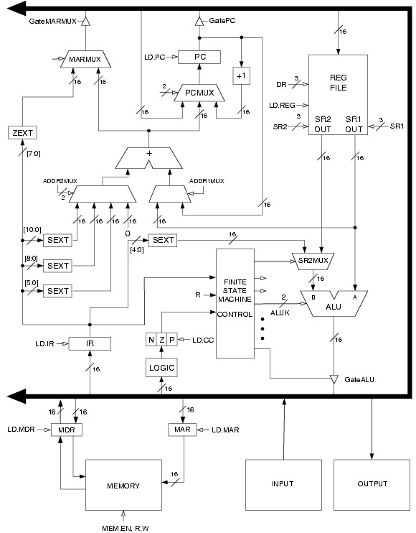

Slide 20
Data Path Components
Global bus
  special wires that carry a 16-bit signal to many components
  inputs to the bus are “tri-state devices,” that only place a signal on the bus when they are enabled
  only one (16-bit) signal should be enabled at any time
    control unit decides which signal “drives” the bus
  any number of components can read the bus
    register only captures bus data if it is write-enabled by the control unit
Memory
  Control and data registers for memory and I/O devices
  memory: MAR (mem address reg) MDR (mem data reg).

Slide 21
Data Path Components
ALU
  Accepts inputs from register file and from sign-extended bits from IR (immediate field).
  Output goes to bus.
    used by condition code logic, register file, memory
Register File
  Two read addresses (SR1, SR2), one write address (DR)
  Input from bus
    result of ALU operation or memory read
  Two 16-bit outputs
    used by ALU, PC, memory address
    data for store instructions passes through ALU

Slide 22
Data Path Components
PC and PCMUX
  Three inputs to PC, controlled by PCMUX
    PC+1 – FETCH stage
    Address adder – BR, JMP
    bus – TRAP (discussed later)
MAR and MARMUX
  Two inputs to MAR, controlled by MARMUX
    Address adder – LD/ST, LDR/STR
    Zero-extended IR[7:0] -- TRAP (discussed later)

Slide 23
Data Path Components
Condition Code Logic
  Looks at value on bus and generates N, Z, P signals
  Registers set only when control unit enables them (LD.CC)
Control Unit – Finite State Machine
  On each machine cycle, changes control signals for next phase of instruction processing
    who drives the bus? (GatePC, GateALU, …)
    which registers are write enabled? (LD.IR, LD.REG, …)
    which operation should ALU perform?
    …
  Logic includes decoder for opcode, etc.

